Slide 1
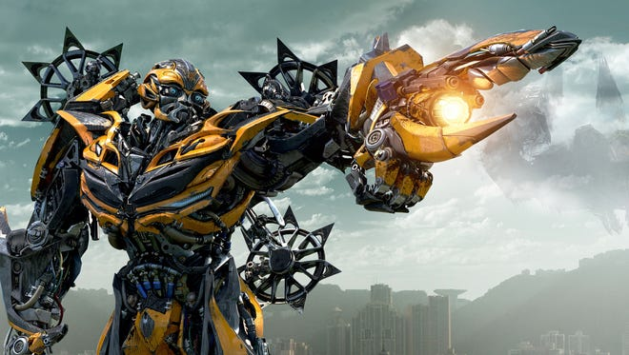
Transformer
Wenxi Li
2022/03/22

Slide 2
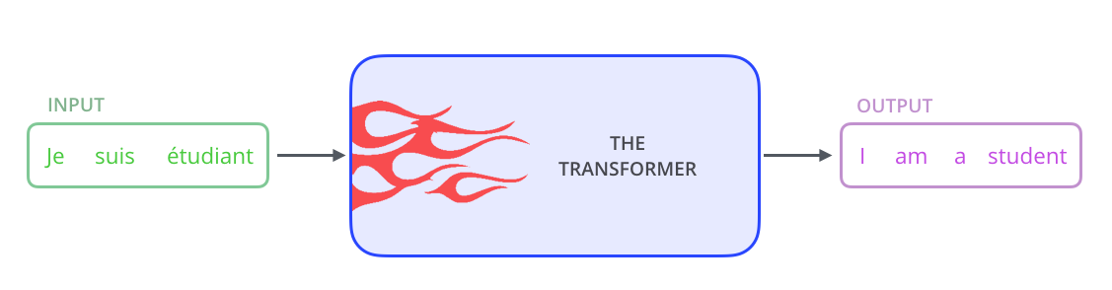
High Level Look

Slide 3
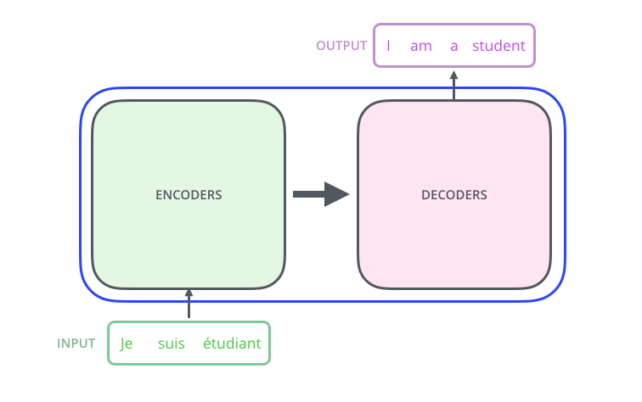

Slide 4
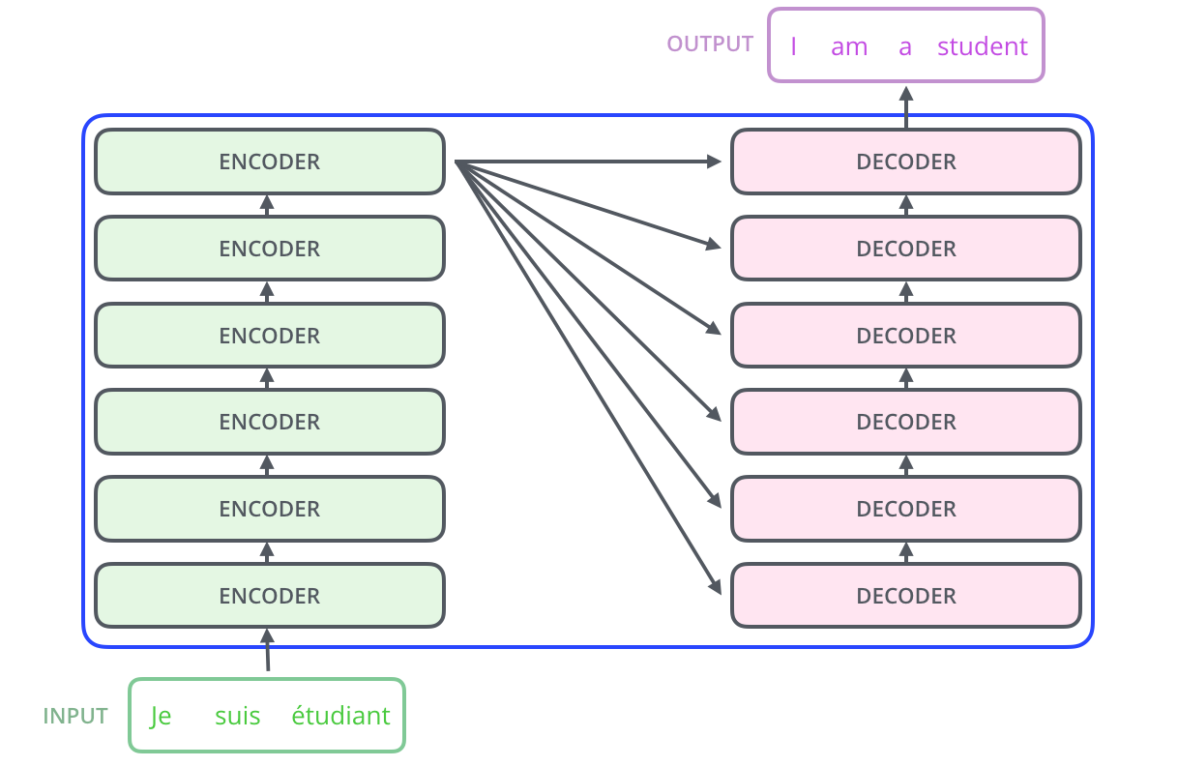

Slide 5
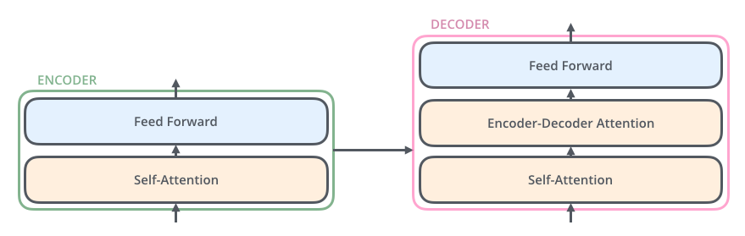
First proposed: Attention is all you need

Slide 6
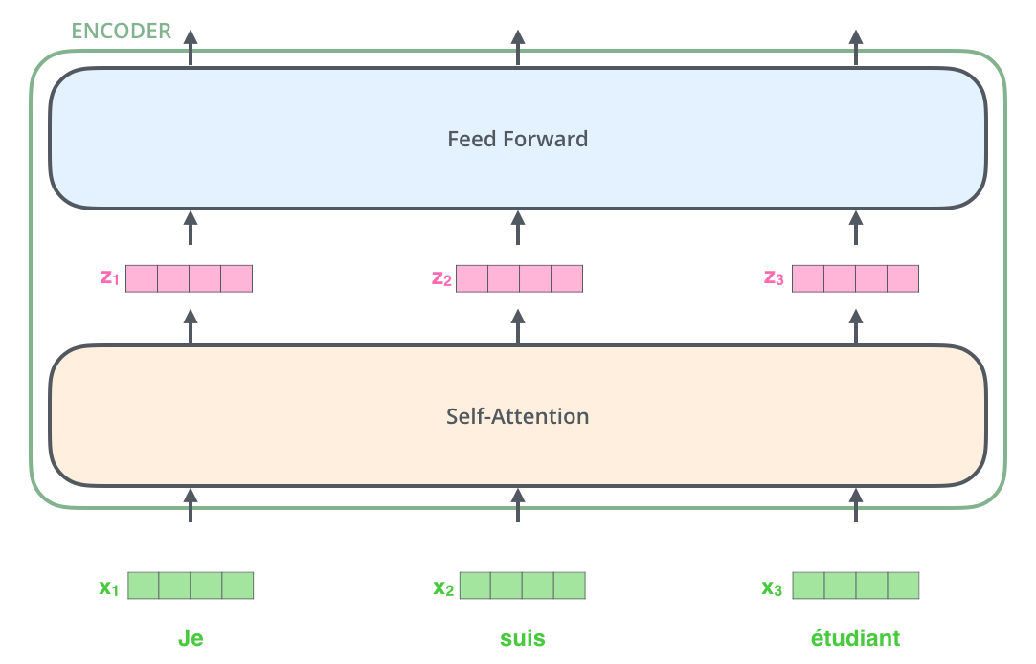
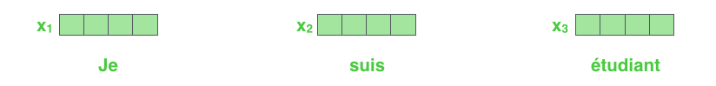
Embedding: turn word into vector
Each word is embedded into a vector of size 512.
Embedding only happens to the bottom-most encoder

Slide 7
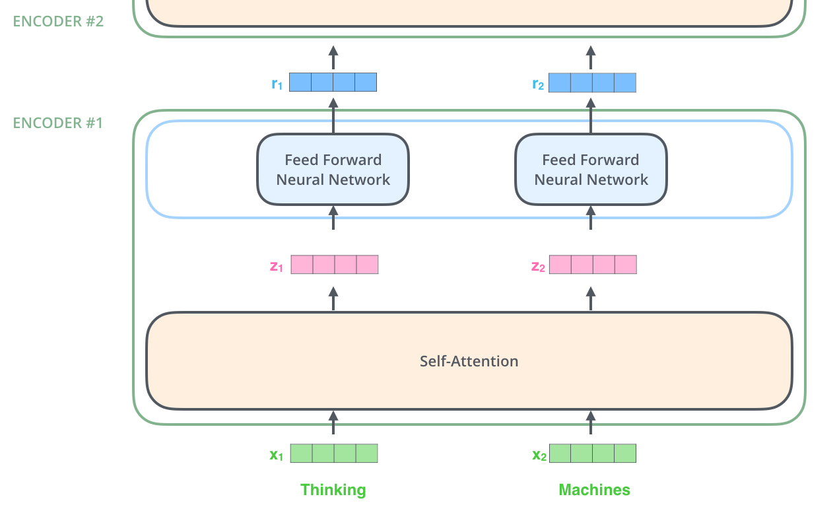
Encoding

Slide 8
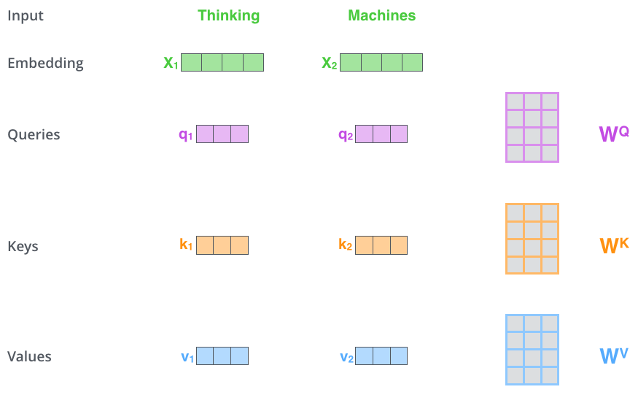
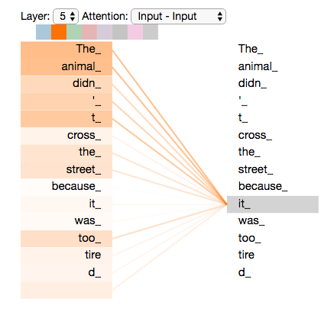
Self-Attention
”The animal didn't cross the street because it was too tired”
The first step in calculating self-attention is to create three vectors from each of the encoder’s input vectors (in this case, the embedding of each word).
Notice that these new vectors are smaller in dimension than the embedding vector. Their dimensionality is 64, while the embedding and encoder input/output vectors have dimensionality of 512. They don’t HAVE to be smaller, this is an architecture choice to make the computation of multiheaded attention (mostly) constant.

Slide 9
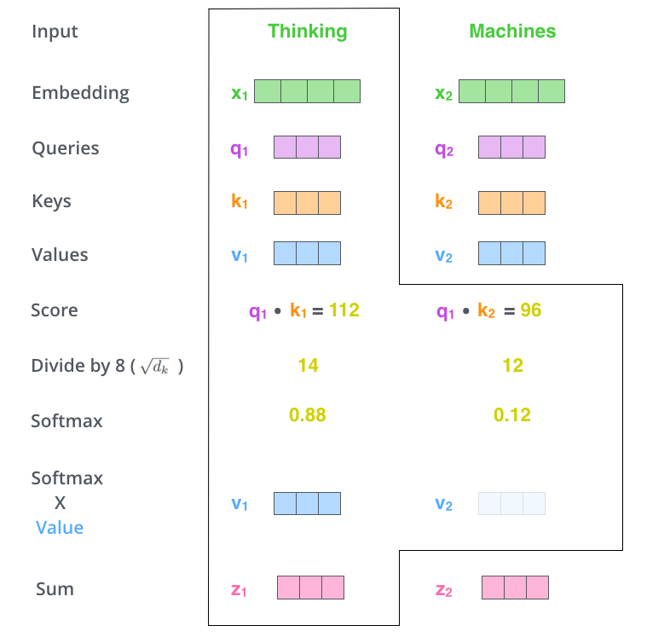
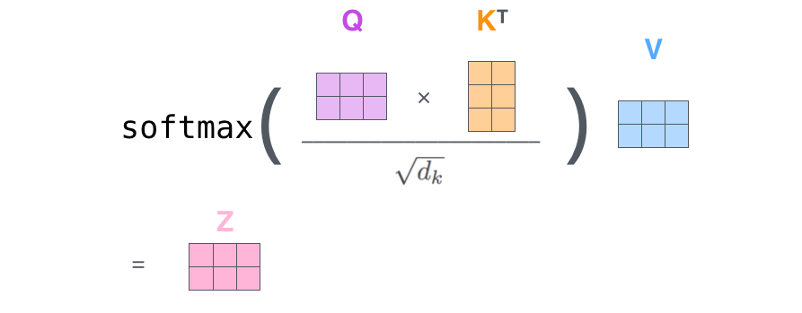

Slide 10
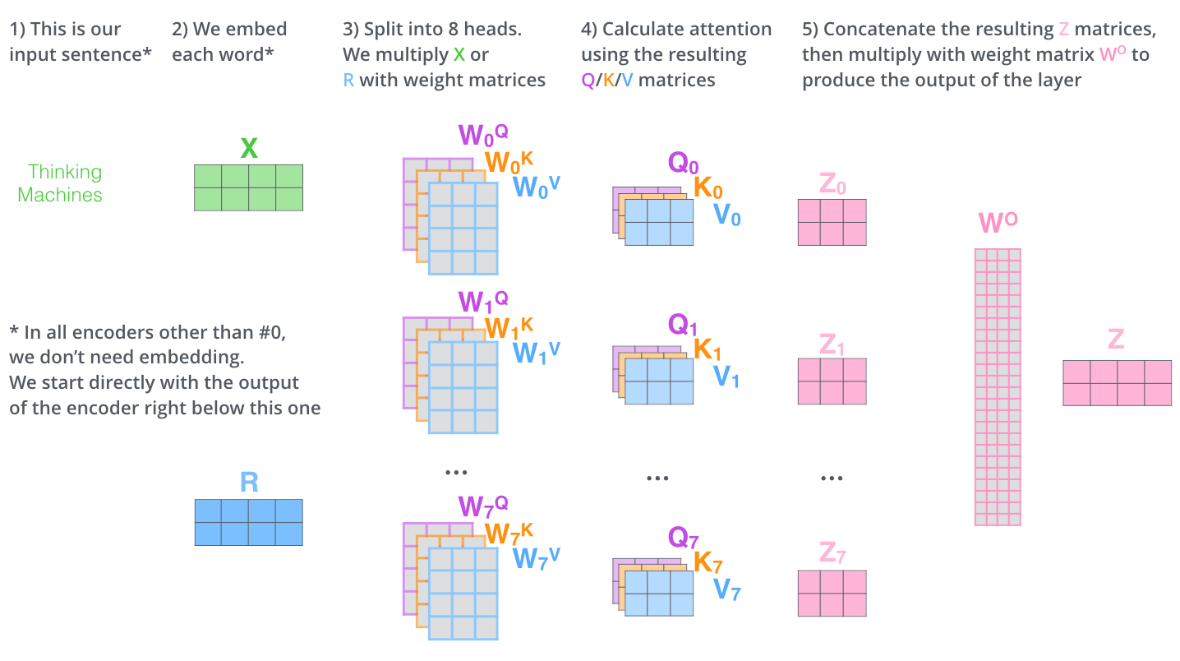

Slide 11
Decoder

Slide 12
Reference: https://jalammar.github.io/illustrated-transformer/

